Slide 1

INTRODUCING THE CLOUD

Slide 2
AGENDA
Introducing the cloud and the cloud providers
Common cloud concepts
AWS, Azure, GCP observations
Cloud comparisons
2
© 2023 by Innovation In Software Corporation

Slide 3
Cloud Computing
Cloud Computing
A Quick Tour of Cloud Offerings
Cloud Case Studies
Knowledge Checks
Backup Slides
3
© 2023 by Innovation In Software Corporation

Slide 4
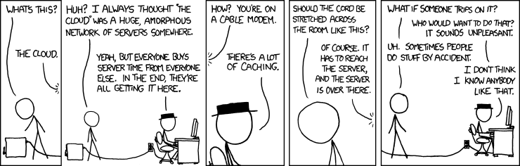
WHAT IS CLOUD COMPUTING
Shared resources
On-demand
Easily scalable
Accessed via internet
4
© 2023 by Innovation In Software Corporation

Slide 5
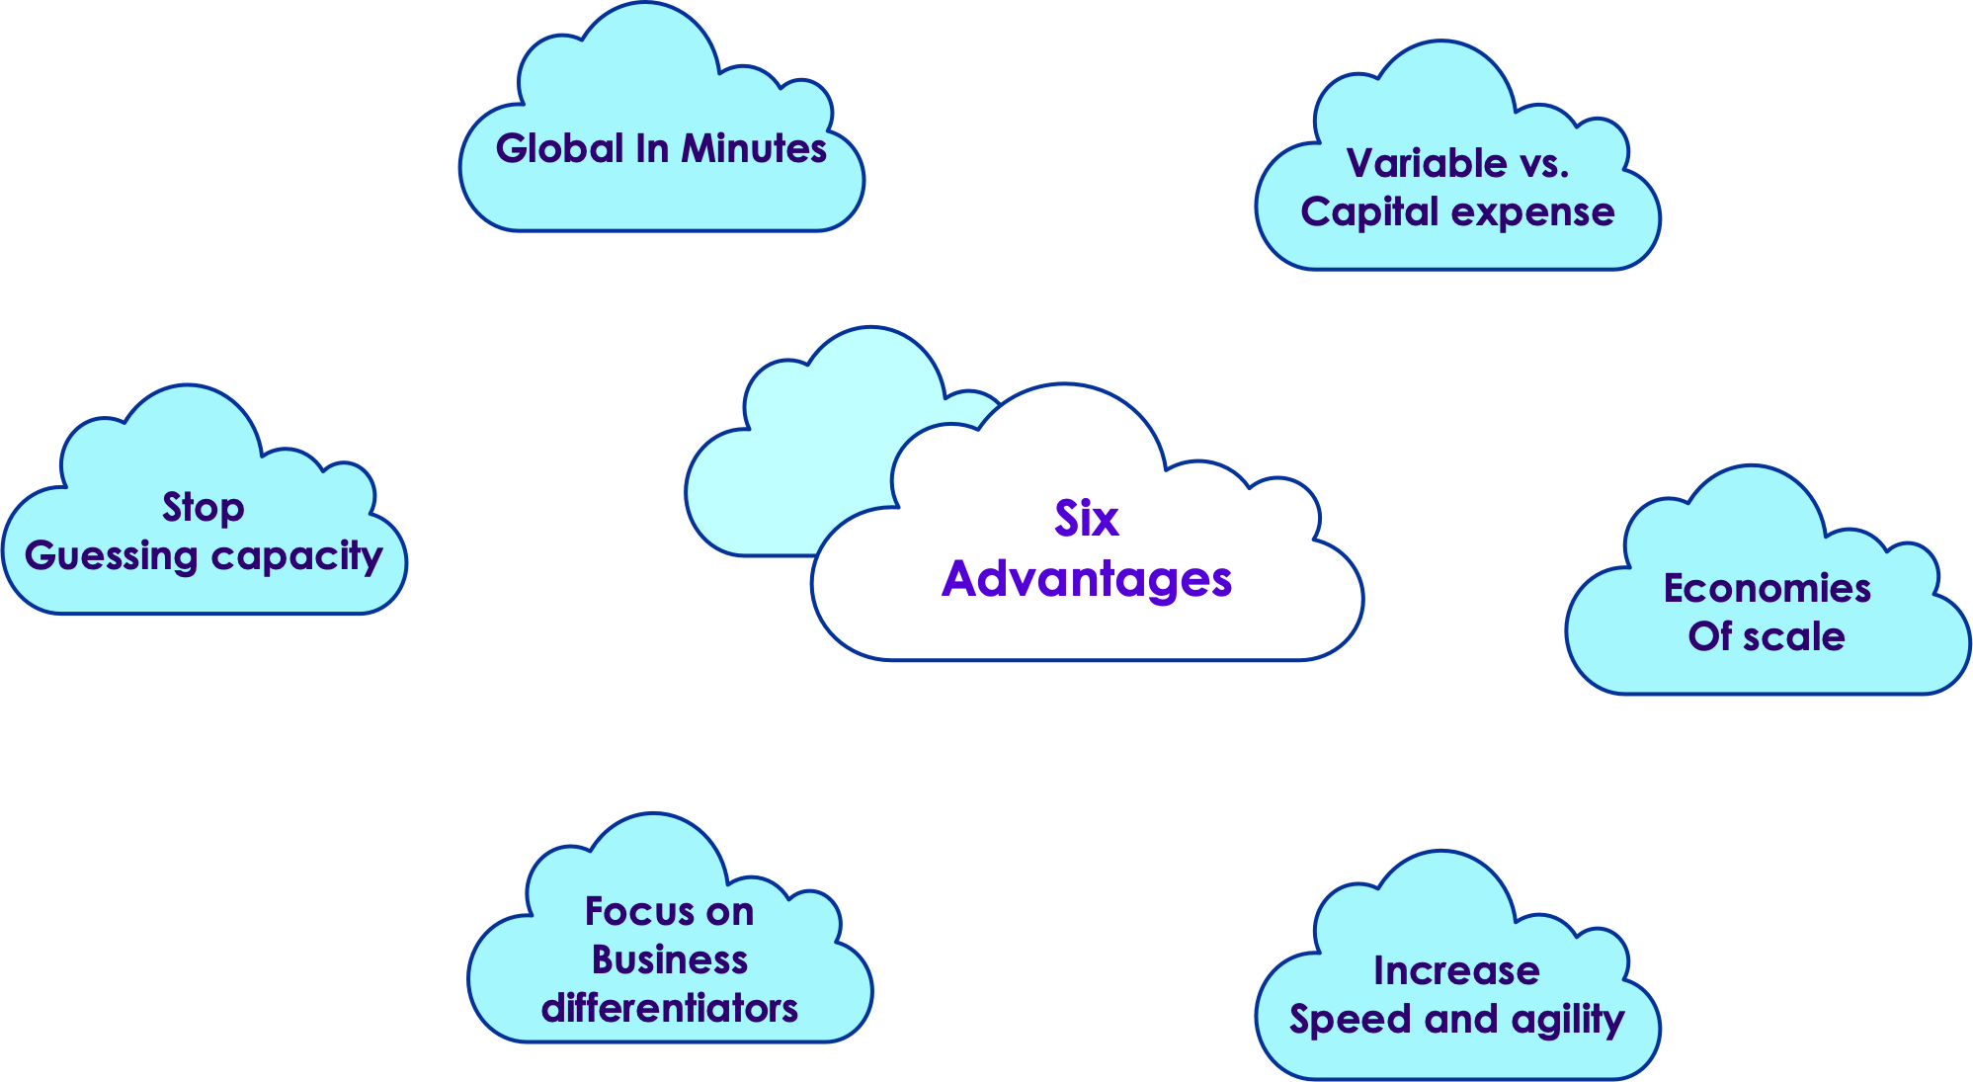
ADVANTAGES OF CLOUD
5
© 2023 by Innovation In Software Corporation

Slide 6
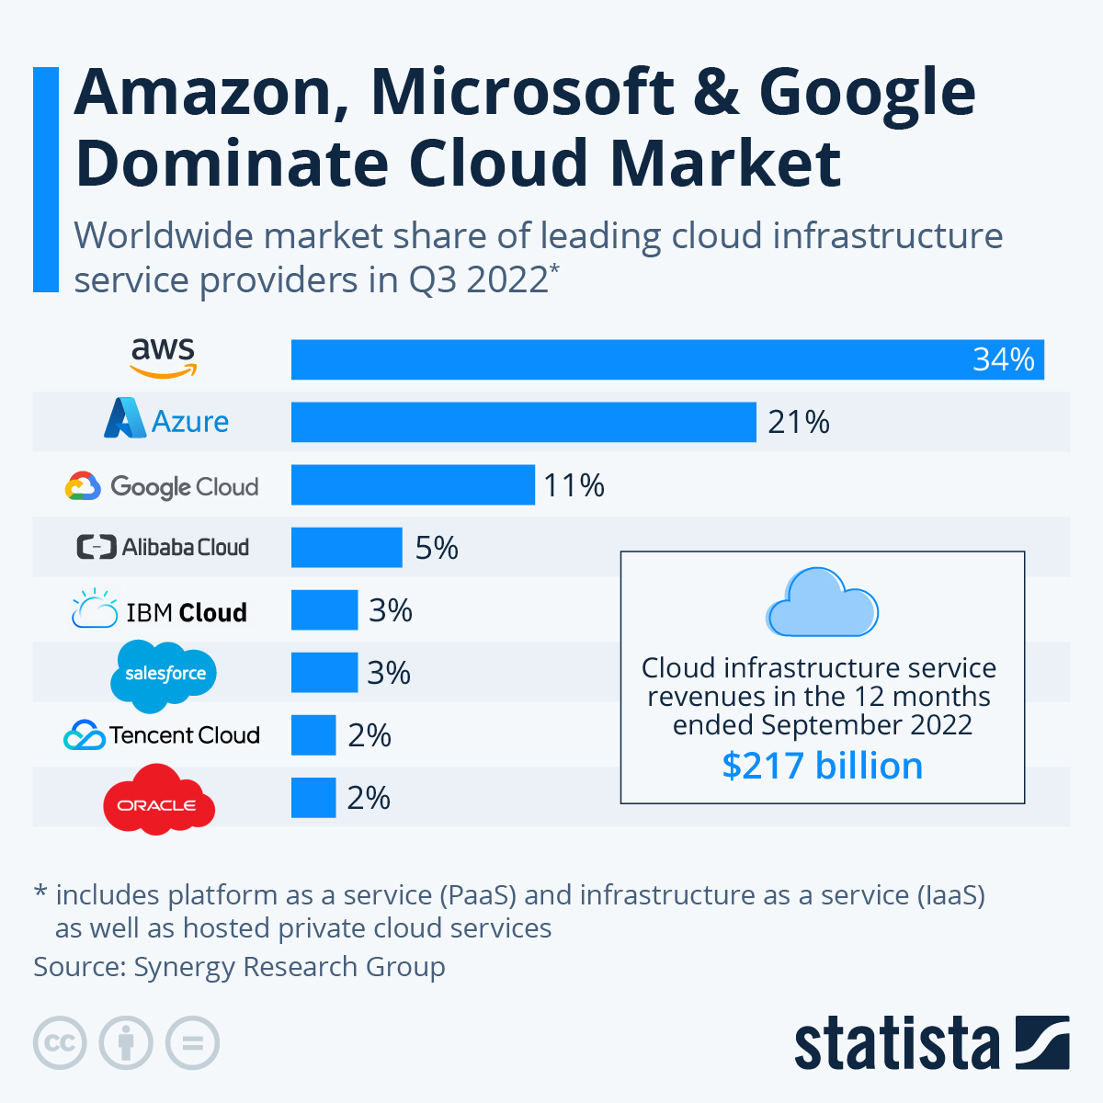
CLOUD MARKET SHARE
6
© 2023 by Innovation In Software Corporation

Slide 7
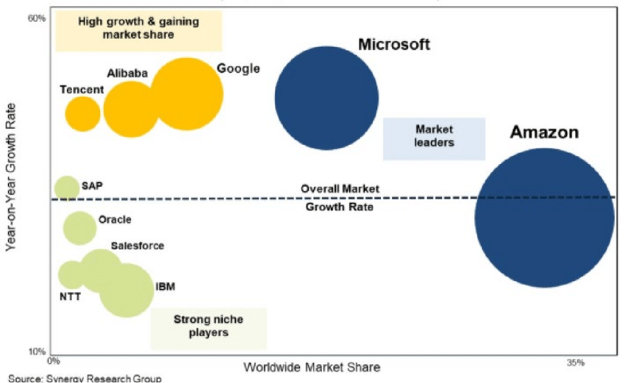
MARKET PLAYERS POSITIONING
Source
7
© 2023 by Innovation In Software Corporation

Slide 8
AWS VS AZURE VS GCP
The major providers have all the core functionalities covered well
AWS:
80 Availability Zones within 25 geographic regions around the world, with announced plans for 15 more Availability Zones and 5 more AWS Regions in Australia, India, Indonesia, Spain, and Switzerland.
Azure:
54 regions worldwide, available in 140 countries
GCP:
25 regions, 76 zones, 200 + countries
Resources
Cloud feature comparison
8
© 2023 by Innovation In Software Corporation

Slide 9
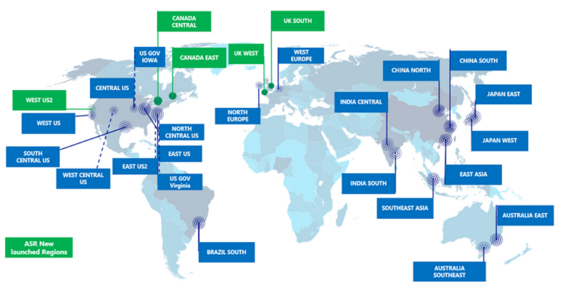
AZURE REGIONS
Azure Regions

Slide 10
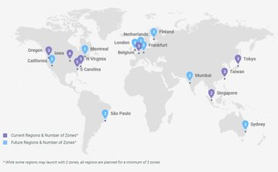
GCP REGIONS
Google Cloud Regions

Slide 11
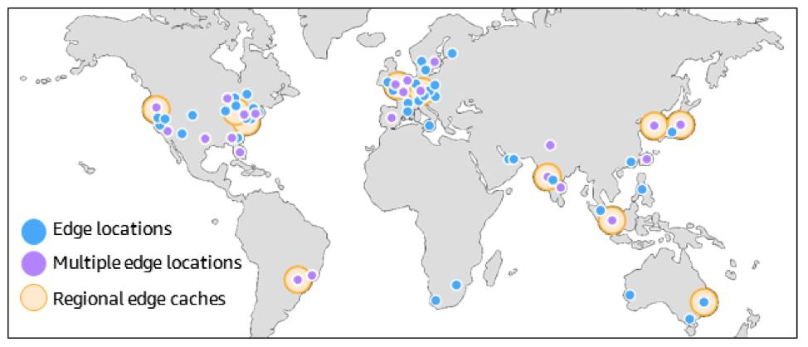
AWS REGIONS
AWS Regions

Slide 12
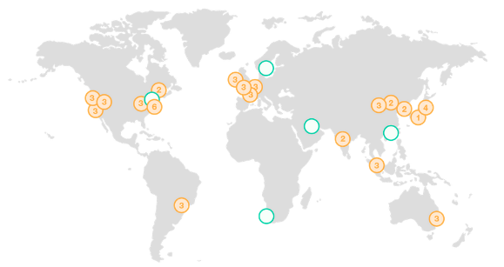
REGIONS AND AVAILABILITY ZONES
Each region consists of multiple availability zones.
Each availability zone is physically separated and isolated from the others.
All availability zones within a region are connected via highly redundant, low-latency, high-speed networks.
9
© 2023 by Innovation In Software Corporation

Slide 13
REGIONS AND AZ BEST PRACTICES
Nearest to your physical location and/or your users’ location to minimize network latency
Not all regions are equal
Service offerings (newly deployed services are first offered in selected regions only)
Pricing is not equal across multiple regions; use cost calculators
Service Level Agreement (SLA) will vary by region
Compliance such as GDPR is specific to a country therefore, it varies region-to-region
Example: IRB-approved data with an audience that spans continents
10
© 2023 by Innovation In Software Corporation

Slide 14
FAULT TOLERANCE WITH MULTIPLE AVAILABILITY ZONES
If you distribute your instances across multiple Availability Zones and one instance fails, you can design your application so that an instance in another Availability Zone can handle requests
Availability Zones give you the flexibility to launch production apps and resources that are highly available, resilient/fault-tolerant, and scalable as compared to using a single data center
Large files (videos ..etc) may be better delivered through CDN. Cloud vendors usually offer Content Delivery Network (CDN)
11
© 2023 by Innovation In Software Corporation

Slide 15
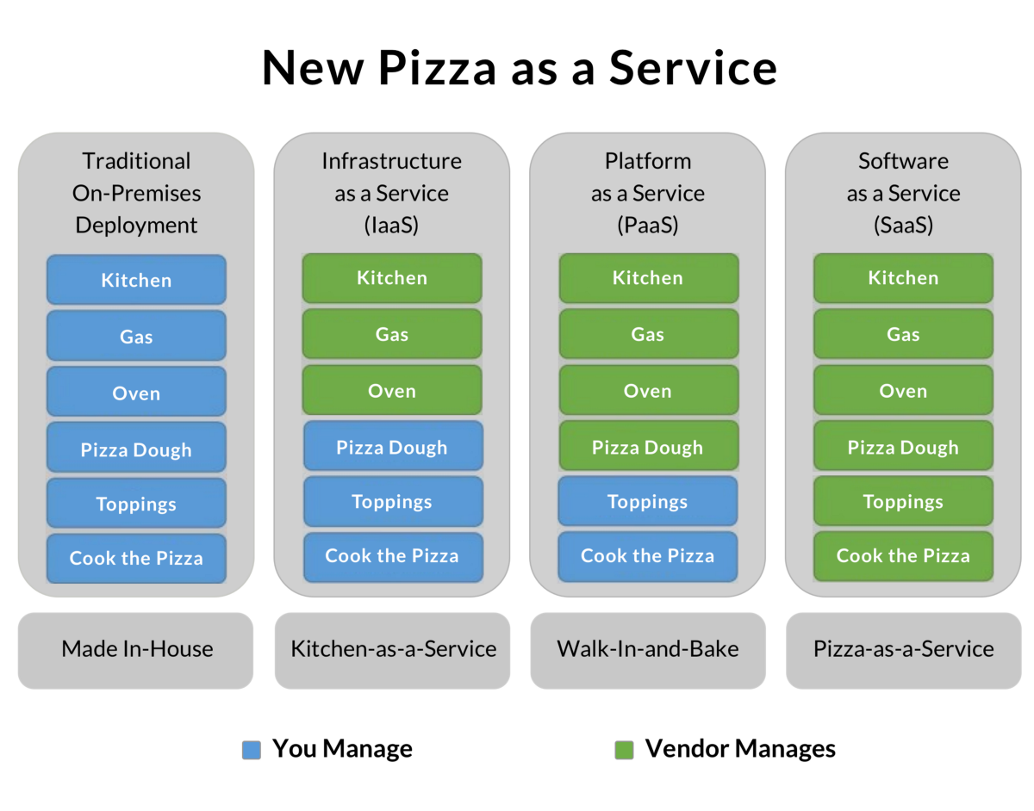
CLOUD SERVICE MODELS FOR PIZZA
12
© 2023 by Innovation In Software Corporation

Slide 16
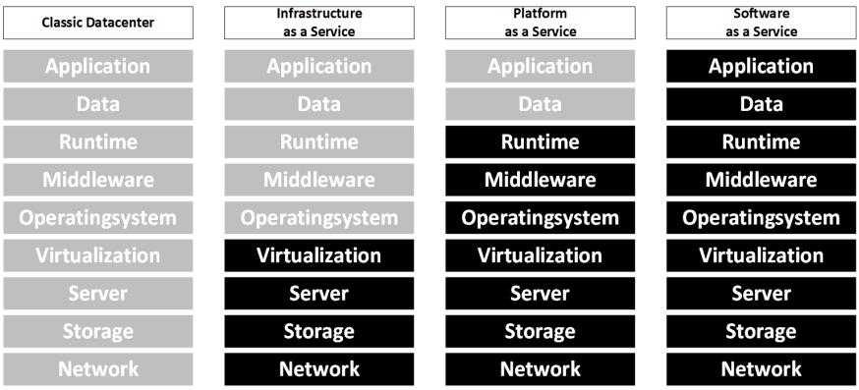
CLOUD SERVICE MODELS
Grey: we manage
Black: Cloud provider manages
13
© 2023 by Innovation In Software Corporation

Slide 17
CLOUD MIGRATION STRATEGIES
6 Strategies for Migrating Applications to the Cloud, or 6 R 's
Rehosting — Otherwise known as “lift-and-shift.”
Replatforming — sometimes called this “lift-tinker-and-shift.”
Repurchasing — Moving to a different product.
Refactoring / Re-architecting
Retire — Get rid of.
Retain — Usually this means “revisit” or do nothing (for now).
Resources
6-strategies-for-migrating-applications-to-the-cloud
14
© 2023 by Innovation In Software Corporation

Slide 18
A Quick Tour of Cloud Offerings
Cloud Computing
A Quick Tour of Cloud Offerings
Cloud Case Studies
Knowledge Checks
Backup Slides
15
© 2023 by Innovation In Software Corporation

Slide 19
CLOUD MARKET SHARE
16
© 2023 by Innovation In Software Corporation

Slide 20
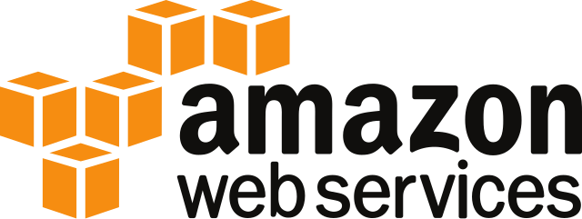
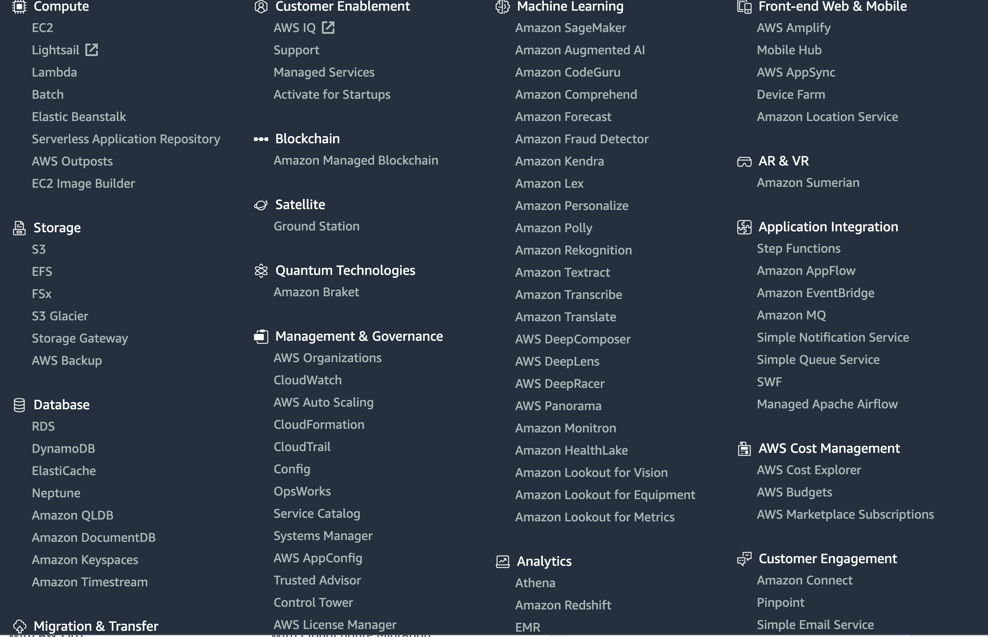
AWS (AMAZON WEB SERVICES)
AWS is the very first public cloud service to be launched
AWS is current market leader in Cloud space (34% marketshare)
AWS offers more than 1,000 services, and it keeps adding services at regular intervals.
aws.amazon.com
17
© 2023 by Innovation In Software Corporation

Slide 21
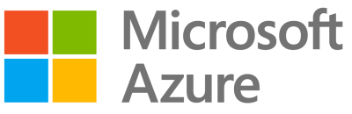
MICROSOFT AZURE
Azure is Microsoft's portfolio of integrated cloud services, built for developers and IT professionals
Launched in 2010, growing very rapidly (2nd to AWS)
Microsoft pivoted to Cloud First strategy. Everything that Microsoft builds and develops is first made for Azure and Microsoft's other cloud offerings.
In addition to the standard cloud components (Compute, Storage ..etc), Azure also offers proprietary Microsoft technologies, like Windows Desktops, Active Directory ..etc
ortal.azure.com
18
© 2023 by Innovation In Software Corporation

Slide 22
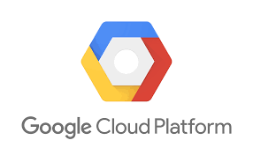
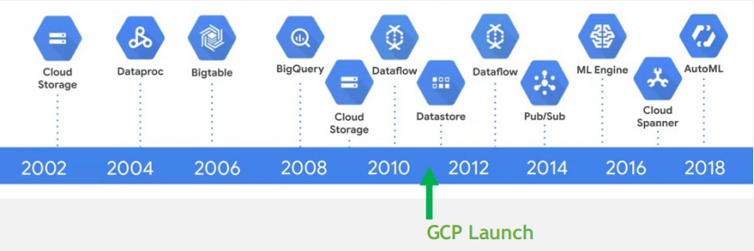
GOOGLE COMPUTE PLATFORM (GCP)
Google had had a long history of building cloud-enabling technology (with a heavy focus on big data) before its cloud services were launched
They are a late comer to the 'public cloud' and 3rd in market cap
rying to differentiate themselves in Machine Learning / AI space
19
© 2023 by Innovation In Software Corporation

Slide 23
A CLOUD STACK
Here is a typical stack in the cloud.
Most vendors would offer these in some form.
Stack | Description
Compute | On demand virtual machines
Servless Compute | Computation without explicitly provisionion VMs
Storage | On demand, scalable storage
Databases | Managed datastores (SQL and noSQL)
Containers | Container hosting and serving (Docker, Kubernetes ..etc)
Queue | Managed queue services for streaming data
Analytics | Analytics stack often supporting Big Data
Machine Learning | Hosted ML/DL infrastructure
Monitoring | Monitor infrastructure, gather and analyze logs
20
© 2023 by Innovation In Software Corporation

Slide 24

COMPUTE SERVICES
Services | AWS | Azure | GCP
IaaS | Amazon Elastic Compute Cloud | Virtual Machines | Google Compute Engine
PaaS | AWS Elastic Beanstalk | App Service and Cloud Services | Google App Engine
Containers | Amazon Elastic Compute Cloud Container Service | Azure Kubernetes Service (AKS) | Google Kubernetes Engine
Serverless Functions | AWS Lambda | Azure Functions | Google Cloud Functions
21
© 2023 by Innovation In Software Corporation

Slide 25
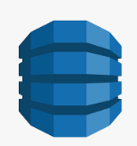
STORAGE
Services | AWS | Azure | GCP
Object Storage | Amazon Simple Storage Service | Azure Blob Storage | Google Cloud Storage
Block Storage | Amazon Elastic Block Store | Azure Block Storage | Google Compute Engine Persistent Disks
Cold Storage | Amazon Glacier | Azure Archive Blob Storage | Google Cloud Storage Nearline
File Storage | Amazon Elastic File System | Azure File Storage | Google Filestore
22
© 2023 by Innovation In Software Corporation

Slide 26
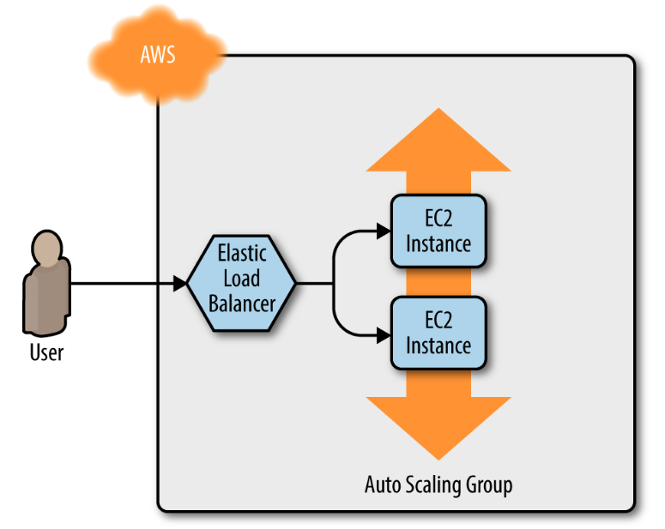
NETWORKING
Services | AWS | Azure | GCP
Virtual Network | Amazon Virtual Private Cloud (VPC) | Virtual Networks (VNets) | Virtual Private Cloud
Load Balancer | Elastic Load Balancer | Load Balancer | Google Cloud Load Balancing
Peering | Direct Connect | ExpressRoute | Google Cloud Interconnect
DNS | Amazon Route 53 | Azure DNS | Google Cloud DNS
23
© 2023 by Innovation In Software Corporation

Slide 27
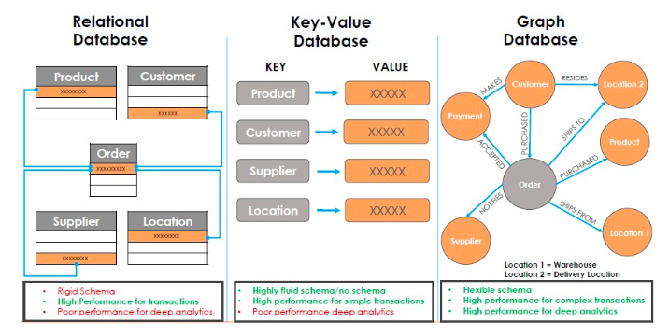
DATASTORES
Services | AWS | Azure | GCP
RDBMS | Amazon Relational Database Service | SQL Database | Google Cloud SQL
NoSQL: Key–Value | Amazon DynamoDB | Table Storage | Google Cloud Firestore/Google Cloud Bigtable
NoSQL: Indexed | Amazon SimpleDB | Azure Cosmos DB | Google Cloud Datastore
24
© 2023 by Innovation In Software Corporation

Slide 28
COMPARING CLOUD VENDORS
Please keep in mind, this is a very fluid market and things change very rapidly
More references
This differentiates core service offerings
This is community sourced and has a feature matrix
AWS | Azure | GCP
Maturity | Great for developers | Aggressive growth
Service portfolio | Integration with open source | Attractive pricing models
Presence (market and geography) | Private datacenter integration | Best for AI and machine learning applications
25
© 2023 by Innovation In Software Corporation

Slide 29
Cloud Case Studies
Cloud Computing
A Quick Tour of Cloud Offerings
Cloud Case Studies
Knowledge Checks
Backup Slides
26
© 2023 by Innovation In Software Corporation

Slide 30
AWS CASE STUDIES
Netflix
100,000+ server instances for streaming / video encoding
Amazon 53 DNS
Amazon S3 as data storage: PB+ data created each day
References: 1
JP Morgan Chase
450+ PB data stored and served by AWS S3
References: 1
See more case studies here: 1
27
© 2023 by Innovation In Software Corporation

Slide 31
GCP CASE STUDIES
Twitter
Ad engagement platform
Moved from home grown big data storage into Google Big Table
References: 1
UPS
Package routing system
BigQuery for adhoc queries
Running BigQuery + ML on 1 billion data points per day!
References: 1
See more case studies here: 1
28
© 2023 by Innovation In Software Corporation

Slide 32
AZURE CASE STUDIES
M&S (Marks and Spencer - Retail, UK)
Consolidated data platform on Azure Data Lake
Azure Databricks for large scale data analytics
Azure PowerBI for reporting
References: 1
AMD
Chip design (EDA) on Azure HPC
Large data storage at Azure Data Lake
References: 1
References: 1
29
© 2023 by Innovation In Software Corporation

Slide 33
Knowledge Checks
Cloud Computing
A Quick Tour of Cloud Offerings
Cloud Case Studies
Knowledge Checks
Backup Slides
30
© 2023 by Innovation In Software Corporation

Slide 34
QUICK KNOWLEDGE CHECK
Which is the order of cloud leaders, by market size?
A) Azure, GCP, AWS
B) GCP, Azure, AWS
C) AWS, GCP, Azure
D) AWS, Azure, GCP
31
© 2023 by Innovation In Software Corporation
Notes:
The correct answer is D

Slide 35
QUICK KNOWLEDGE CHECK
Which represents the correct order, from the most to the least amount of work done by you?
A) On Prem, IaaS, PaaS, SaaS
B) SaaS, PaaS, IaaS, On Prem
C) IaaS, PaaS, SaaS, On Prem
D) SaaS, IaaS, PaaS, On Prem
32
© 2023 by Innovation In Software Corporation
Notes:
The correct answer is B

Slide 36
QUICK KNOWLEDGE CHECK
A company wants to move to the cloud as their existing data center lease is expiring. What migration strategy should a company adopt for quickly migrating their existing applications to cloud?
A) Replatform
B) Retain
C) Repurchase
D) Rehost
33
© 2023 by Innovation In Software Corporation
Notes:
The correct answer is D, Rehost.
Rehost or Lift and Shift allows an organization to quickly scale the migration by provisioning compute instances and running the same application stack on the cloud.

Slide 37
QUICK KNOWLEDGE CHECK
Which of these strategies takes more time to execute?
A) Retain
B) Replatform
C) Rehost
D) Rearchitect
34
© 2023 by Innovation In Software Corporation
Notes:
The correct answer is D, Rearchitect.
Rearchitect or Refactor strategy involves changing the architecture of the application by employing cloud-native features. This strategy takes more time to execute but can be an effective way to meet business needs that are difficult to achieve in a traditional setup.

Slide 38
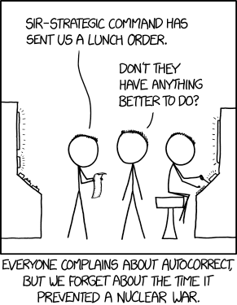
END OF MODULE
35
© 2023 by Innovation In Software Corporation

